Slide 1
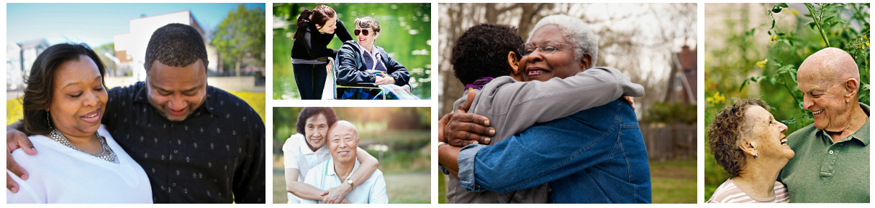
<Your Organization Name Here>
Notes:
Key Points: Welcome and Thanks. Outline what is going to happen.
Script (all script points are suggestions):
Thank you for that kind introduction. And thank YOU all for making time in your busy schedules to learn about The Conversation Project. There is a sign up sheet going around. Thanks for signing in!
Over the next (# of) minutes, we are going to enter territory most people do their best to avoid: we will think and talk together about our wishes for care through the end of our lives.
I will introduce The Conversation Project’s free Conversation Starter Guide which is designed to help you get started on having a conversation with those important to you. I hope you will leave this session with:
-Less anxiety about starting a conversation about what matters most to you;
-Some tips and tools for initiating the conversation;
-And a commitment to express your wishes and engage others in expressing theirs.
(If there is going to be a follow up session, explain that now and give the dates now and at the end.)

Slide 2
My story
2
Feel free to share your organization’s or your personal story surrounding care through the end of life and why you are leading today’s session.
Add a photo(s) for visual interest
Notes:
Key Point: Let people know who you are and why you are motivated to share The Conversation Project. Personal/positive stories help connect to the audience.

Slide 3
Introductions & stories
3
Your preferred name
Your organization (if professional setting)
Share a time when you experienced a death - either personally or professionally – and if wishes of that person were known/unknown.
  OR
Share an experience of being a proxy
  OR
Share a time when someone couldn’t speak for themselves due to illness or accident
X minutes
Notes:
Key Point: Finding out who is in the room and creating a comfortable setting for sharing. If you have more time allotted for this and feel the need, you could take the time for everyone to go around the room to say their names/organizations (in groups less than 8). Or, in a larger group have people share in pairs or threes:
Script: We know that everyone has a story…A story of an experience with death or of serving as someone’s proxy or maybe a time when someone wasn’t able to speak for themselves due to an accident or illness. Someone you care about…a patient…a friend…a family member. As you recall your story, think about whether you had an opportunity to talk about what their wishes for care were…and whether those wishes were respected…We’d like to make time for you to briefly share your story. Please arrange yourselves in groups of two (or three) and then I will give you instructions. Please: if you are here with a partner, spouse, or family member, try to arrange yourselves to be in different groups.
[Once arranged]: Please introduce yourself, sharing your name and organization. Next, recall a time when you experienced a death—personally or professionally. Share whether you think the person’s wishes were known and respected. As you are comfortable, take three minutes to share the heart of that story with your group. I will ring a bell (or however you will do this) at three minute intervals which means you may thank people for listening and allow the next person to speak. To the people who are listening, that is all you need to do: just listen with a caring heart. Try not to be thinking ahead to what you will say. Listeners don’t need to ask questions or fix anything; allow the person to simply tell their story. Ready? Begin.
[At the end of the exercise]: Thank you! Did you notice what happened? We hear all the time that ‘people don’t want to talk about death or dying…’ And then we give you three minutes and the room is suddenly abuzz with people talking! I think we DO want to talk about it. Most of us are just waiting for an invitation—for a safe space and a caring listener—to tell our story and share our wishes. Thank you for sharing your very important story today…You have demonstrated just how important it is to talk about our wishes for care so that they can be respected…
Tip: This may be a good time to point out to folks that TCP really has no preference for whether or not people want aggressive treatment or aggressive comfort care; everyone’s preferences are unique. We simply encourage you talk about it.

Slide 4
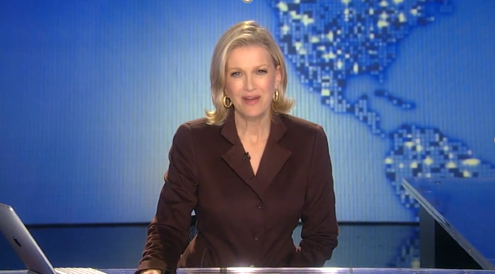
ABC News video
https://youtu.be/J1r0Xbh0UVo
Notes:
Tip: You can use this clip to give an engaging introduction to TCP (Depending on time/audience – this can also be good pre-work for a call, class, event to send out ahead of time)
Note: Clicking on the link will exit the PowerPoint, and open the video on YouTube. You may choose to embed the video into the PowerPoint instead. If you play videos, make sure you have strong internet access and test ahead of time. You can open up You Tube videos and play ahead of time so they are already loaded and ready to go.
Script: To introduce The Conversation Project, let’s watch this video from Diane Sawyer on ABC World News.
Note after watching: We know that not every family looks or acts like the Jennings Family. But we know that talking and listening to each other matters.

Slide 5
Helping people share their wishes for care through the end of life
5
Helping people share their wishes for care through the end of life
Notes:
Script: The Conversation Project is a national public engagement campaign dedicated to assuring that everyone’s wishes for care through the end of life are Understood and Respected. We are raising awareness; providing free, easy-to-use guides on our website; and connecting with people where we live, work, pray and learn. Too many people die in a manner they would not choose, and too many of those that matter most are left feeling bereaved, guilty, and uncertain. The Conversation Project is dedicated to changing the current norm.

Slide 6
Why talking matters
6
We can’t plan for everything. But we can share what matters to us with the people who matter most to us.
Talking creates the foundation of a care plan built on our values—a plan that will be available when the need arises.
Notes:
Script: Why does this matter? We can’t plan for everything. But we can share what matters to us with the people who matter most (people we care for and about). By talking about our values—what matters most to us in our life, and in our health care—we can help those around us make sure we get the kind of health care that’s right for us through the end of life.
Discussing our values and wishes can bring us closer to people. And talking with important people in our lives and our health care team, creates the foundation of a care plan built on what’s important to us that will be available when the need arises.
Note: We have no preference for the type of care someone might want to receive. For us, it is important to encourage these conversations early and often. We know it always seems too soon until it’s too late and that a crisis is a terrible time to learn.

Slide 7

Listening matters too
7
This Photo by Unknown Author is licensed under CC BY-SA
Notes:
Script: Equally important is the second part of a conversation, which tends to be forgotten, LISTENING. Embrace Being Quiet. Turning off our inclination to react, respond or problem solve (which brings in our own biases) is critically important. Acknowledge what someone is saying, lean in to their thoughts, feelings and what matters to them.

Slide 8
Our ultimate goal, after all, is not a good death but a good life to the very end.
~ Atul Gawande
8
Notes:
Script: And an ultimate goal is to have a good life to the very end! We believe that, together, we can transform how we live until the end—one conversation at a time. We also know not everyone is given equal opportunity for a good life. We’ve seen the inequities and racial disparities that COVID laid bare. Not everyone has the luxury or privilege to think about a “good death” when they are struggling to live life, put food on the table, worrying about finances and cost of treatment….and simply living in peace, not just dying in peace. Part of our work is to ensure everyone is reached, listened to and respected – we don’t want to create further inequities of care at end of life.
Note: Can refer folks to The Conversation Project blog, The Other Conversation, pointing to the racial inequities and injustice that we all need to be talking about and taking action to remedy as we work to eliminate disparities in health for black, brown, indigenous and other people of color.

Slide 9
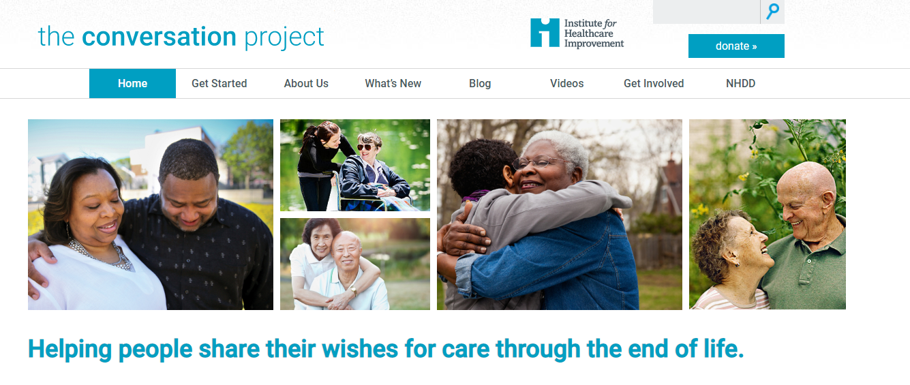
Our website
9
Notes:
Key point: Introduce TCP website and free, downloadable resources.
Script: So, we want to have these conversations…and something gets in our way. We hear that people don’t want to upset those they care about, a family member or dear friend by bringing it up…and we know that people will feel relief if they do start talking. Mostly, people don’t know how to bring it up—or what to talk about.

Slide 10
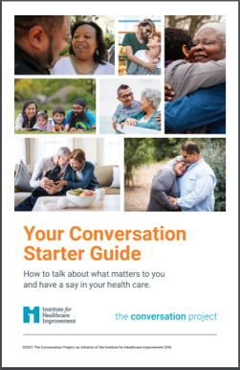
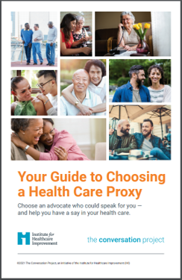
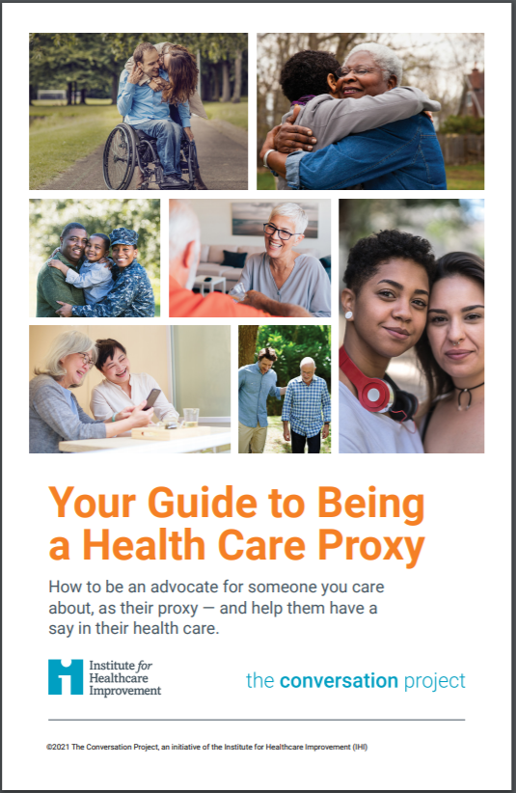
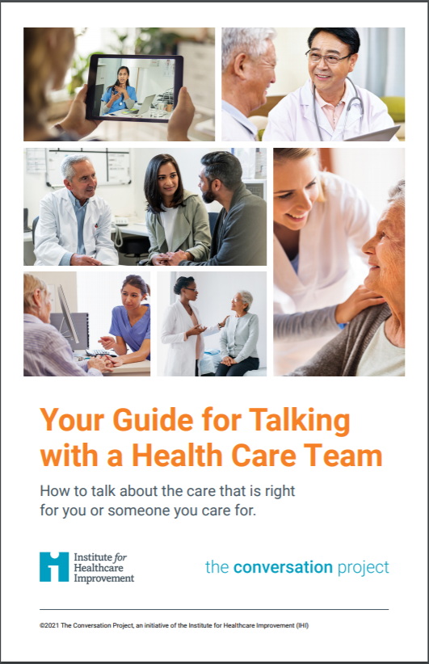
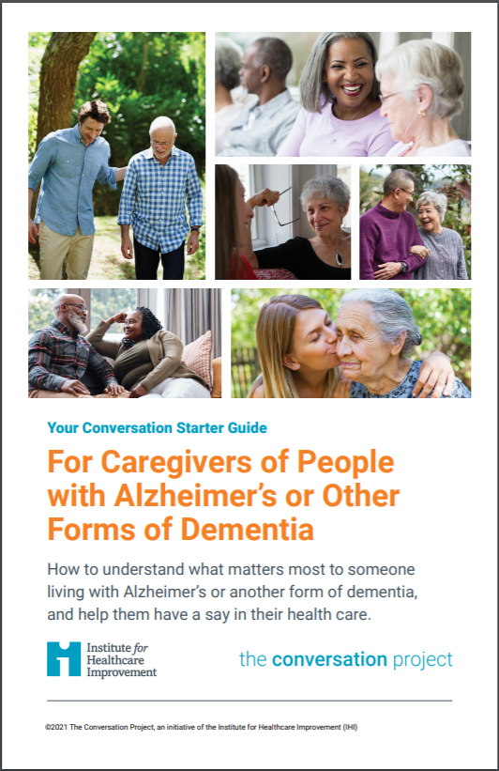
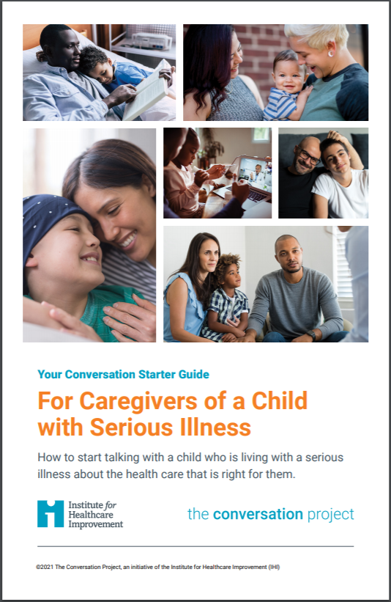
Free tools (in multiple languages)
10
Starting a Conversation
Choosing a Health Care Proxy
Being a Health Care Proxy
Talking with a Health Care Team
Caregivers of People with Alzheimer’s or Other Forms of Dementia
Caregivers of a Child with Serious Illness
Notes:
Script: That is why we created our free Conversation Guides!
In addition to our “flagship” Conversation Guide, there are guides for those caring for someone who is living with Alzheimer’s Disease or another form of dementia; one for talking with a child who is living with a serious illness; one for how to choose a health care proxy (or agent); one on how to be a health care proxy; and one for How to talk with a member of your health care team
You can find these on our website: The Conversation Project dot org
https://theconversationproject.org/get-started
And many of the guides are available in multiple language translations! And, we have an English audio version of our main Starter Guide.
10

Slide 11
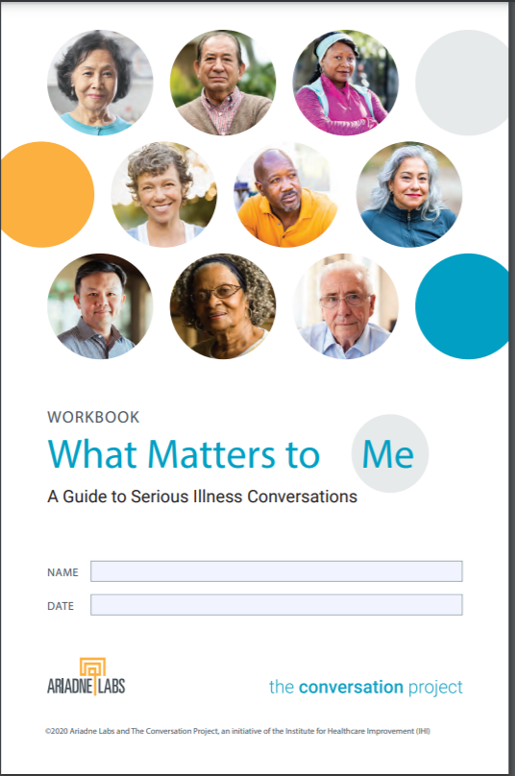
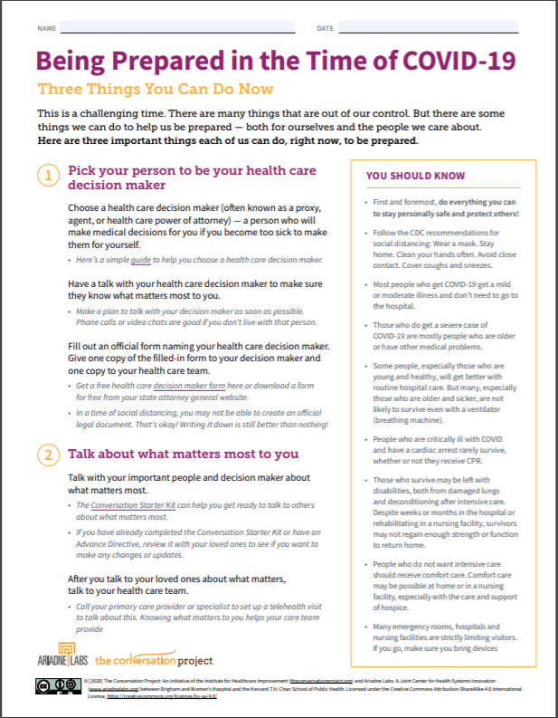
Free tools (in multiple languages)
11
People with a Serious Illness
Being Prepared in the Time of COVID-19
Notes:
Script: …We also have personal workbook for anyone who has been diagnosed with a serious illness and a 2-page guide for all of us on being prepared in the time of COVID-19. Both were created with Ariadne Labs.
You can find these on our website: The Conversation Project dot org
https://theconversationproject.org/get-started
And many of the guides are available in multiple language translations!
11

Slide 12
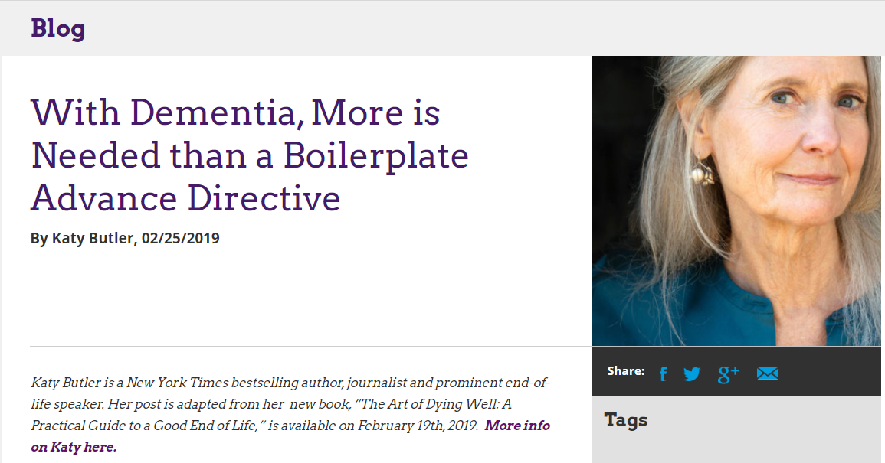

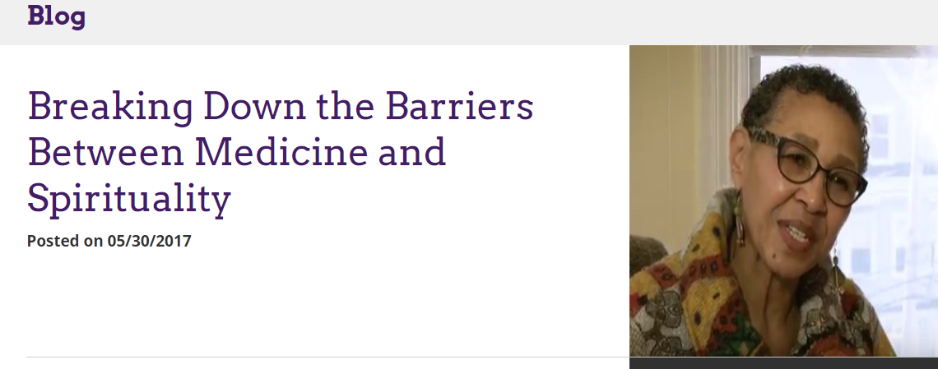

Personal stories
12
Notes:
And... personal stories by folks who have felt moved enough by this topic to share their experiences.

Slide 13
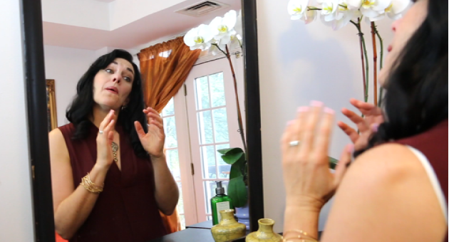
Practice makes perfect video
13
https://youtu.be/pyMXtVprN74
Notes:
Tip: You can show this here to show the types of videos TCP has to help jump start these conversation. After video – we like to note that we are not making light of death, but rather making the topic more lighthearted and accessible so it’s not all gloom and doom. This and other videos help bring some humor and ease the gravity.
Or, you may choose to show rather than tell people some ways to start The Conversation later after the icebreakers in Slide 22
Note: Clicking on the link will exit the PowerPoint, and open the video on YouTube. You may choose to embed the video into the PowerPoint instead. If you play videos, make sure you have strong internet access and test ahead of time. You can open up You Tube videos and play ahead of time so they are already loaded and ready to go.

Slide 14

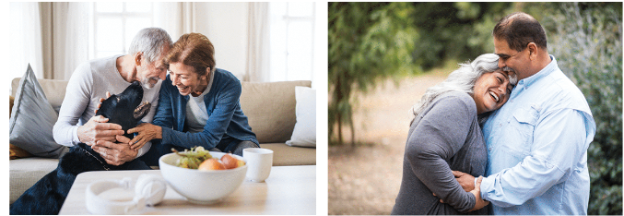
The Conversation Starts with You
Notes:
Key Points: Exemplify having The Conversation! Walk the walk—don’t just talk the talk. Sometimes we give good advice that we haven’t followed for ourselves. There is integrity in doing this work yourself first before asking someone else to do it.
Script: We come to today’s workshop with a variety of perspectives about who we hope will have “The Conversation.” And! We are here to suggest that “The Conversation Starts with YOU”! You see, our thoughts and feelings, beliefs and wishes may not just trip off our tongues, or come popping out of our heads when someone asks: “What do you want for your end of life care??” Though our intentions are good, we really shouldn’t be asking someone ELSE what their wishes are if we haven’t taken a little time to articulate what OUR wishes are. In doing this reflection for ourselves FIRST, we gain some insight into the challenges—and the opportunities/blessings—that are part of having The Conversation. Let’s get started!

Slide 15
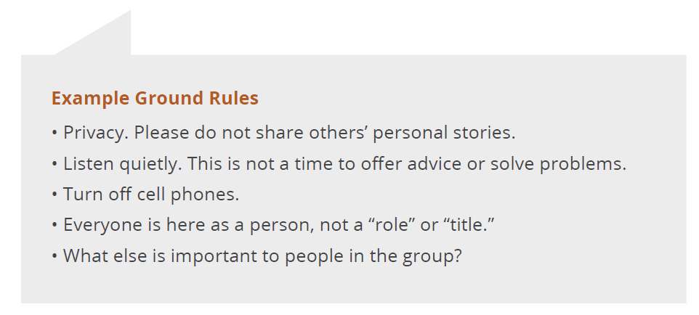
Setting the table
15
How it works
  Give current answers!
  Personal, table, report out
Ground rules
Notes:
Key Point: “Setting the Table”— a comfortable image for normalizing the conversation. And there need to be some ground rules.
Tips: When talking with professional groups, reminding them that while this will help them with client/patient care, this is an opportunity for them to develop capacity to talk with their own families, friends and clinicians.
Note: While people may set up confidentiality ground rules, we also encourage people to take what they hear today and share it widely (e.g. have the conversation!). We ask only that you not share stories with identifying information (e.g. “Sally said that in her family….” vs. “I heard how important it is to talk with everyone in our family so that no one is left in the dark about my wishes.”) Also: We have found that having a starter conversation is easier to do with someone you don’t know vs. diving in for the first time with a close relation, which is why we suggest splitting up the couples or family members when doing these exercises. Finally, please ensure that all attendees are there voluntarily. If this is provided in a work setting, it shouldn’t be forced. Silence is also a very valid form of participation – some folks might not be as comfortable sharing and mostly want to observe – that’s ok.
Script: As we begin to use the Conversation Guide, please keep a few things in mind: When answering any questions for yourself, try to give current answers. That is, answer from where you are right now—in your present tense body and mind health. We will begin with some personal reflection and writing. Next you will be asked to share with someone at your table (and for today’s purposes, we suggest you speak to someone who is NOT your spouse, partner, or family member). Later we will hear from the larger group so we can all learn from one another. (Then review the ground rules on the slide.)

Slide 16
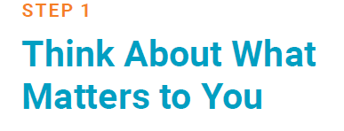
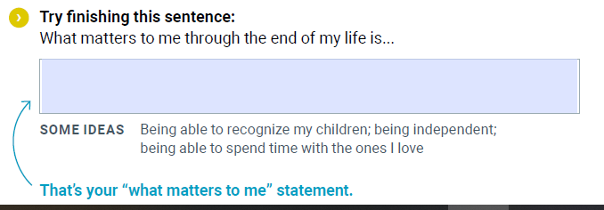
The Starter Guide: Preparation
16
Notes:
Tip: We’ve found that having people do some parts of the Conversation Guide right then and there can really get the wheels turning and give them some ideas on how to get the conversation started once they leave the session vs. simply pointing sections out to people.
-We ask the host organization to print enough Conversation Guides for people to use and take with them. OR, for those hosting virtual events, we suggest the host organization send them printed copied to their homes (remember many may not have access to printers). You can also send the link to the Conversation Guide in advance or pop it into the chat function during a virtual event so participants can download the guide on their computer and follow along. Remind people they can write all over the one provided because they can print more out for free at their home or office. If doing an in-person event, have some extra pens or pencils on hand.
-One workshop leader on our team invites people to close their eyes and silently complete the sample sentence in their minds before writing—a short (1-2 minute) meditation to allow people to settle into the exercise.
Script: So, putting your pens and papers aside for a moment, I invite you, as you are comfortable, to close your eyes for this exercise…Feel your body sitting in the chair….your feet on the floor…and take a conscious breath in….and exhale…This is a signal to yourself that this time is for you…
And now, in the quiet of your own heart and mind, complete this sentence:
When I think about the end of my life, what matters to me is… (Pause and let people reflect. You may wish to repeat the sentence slowly and then pause again for a full minute, saying, “Take just a minute to reflect on this…”
Then: Thank you. Gently open your eyes and please open your Conversation Guide, turn to page ___ and take 2 minutes to write down what occurred to you: bullet points or notes, short phrases, or complete sentences. Your aim is to move what was in your mind or heart and put it into words on the page so you are better prepared to articulate What Matters Most to you. [Time 2 minutes]
That’s not a lot of time to come up with your What Matters Most statements, but it’s a good start on the “Conversation Guide.” Now, let’s pair up with 2 other people to share –as you are comfortable--your What Matters Most thoughts. (You can have people pair up or talk in groups of three. Having 2-3 minutes each seems to be enough people to feel they had enough time to speak and be heard.)
[Bring the group back to attention with a bell or your voice. You can say something like, “I’m sorry to interrupt such wonderful sharing…”]
16

Slide 17
What matters to me…
17
“I want to say goodbye to everyone I love, have one last look at the ocean, listen to some 90’s music, and go.”
“Having my sheets untucked around my feet!”
“Peaceful, pain-free, with nothing left unsaid.”
“In the hospital, with excellent nursing care.”
Notes:
Examples of what matters to people during their care at the end-of-life. Feel free to add your own.

Slide 18
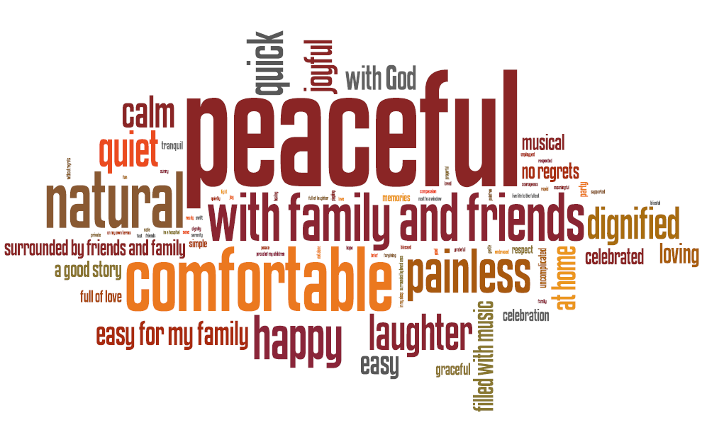
18
Notes:
Script: Sharing your ‘What matters to me’ statement with those that matter most to you could be a big help down the road. It could help them communicate to your health care team what is most important to you—what’s worth pursing treatment for, and what isn’t.
Let’s hear from a few people about what you shared or something that you heard that inspired or surprised you? [Sharing in large group: 3-4 people or about 5 minutes.]
Tip: If people raise questions about medical or ethical topics you don’t feel qualified or comfortable answering, it’s ok to say, “I don’t know,” or “I really can’t comment on that; perhaps that’s a good topic for a future workshop or discussion group.”

Slide 19
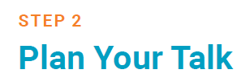
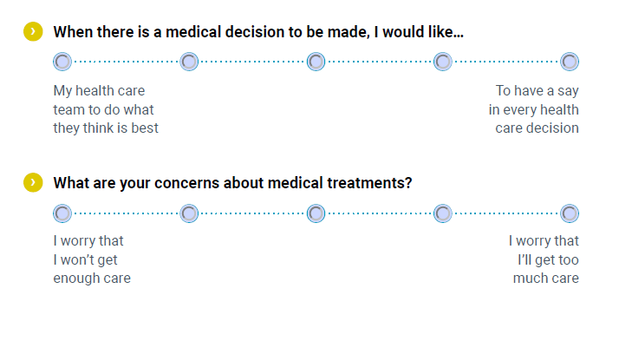
19
Notes:
Script: The next section of the Conversation Guide is all about Planning Your Talk. Having your say in health care is more likely if you share how you feel about certain situations that could arise now and in the future. This part of the Guide is set up with questions and answers on a simple sliding scale, to help you see and share where you fall on a spectrum of possible answers.
Note the three sections:
What role you want to have in the decision-making process?
What kind of care you want to receive?
What role you want your loved ones to play?
Script: Let’s take 5 minutes now to look at the questions and see where you would place your answer along the scale. It’s not a speed test! Just proceed along and stop when you arrive at the section that is headed “Step 3: Start Talking” I’ll let you know when 5 minutes is up.”
[after 5 minutes]: “Let’s just check in. What was that exercise like for you? What did you notice? Were some questions harder to answer than others? Would someone be willing to share?” (Note: A question that causes someone to say that they just don’t know or thought they would answer one way, but ended up answering another way may indicate that this question is a good one to be sure to have a deeper conversation about.)

Slide 20
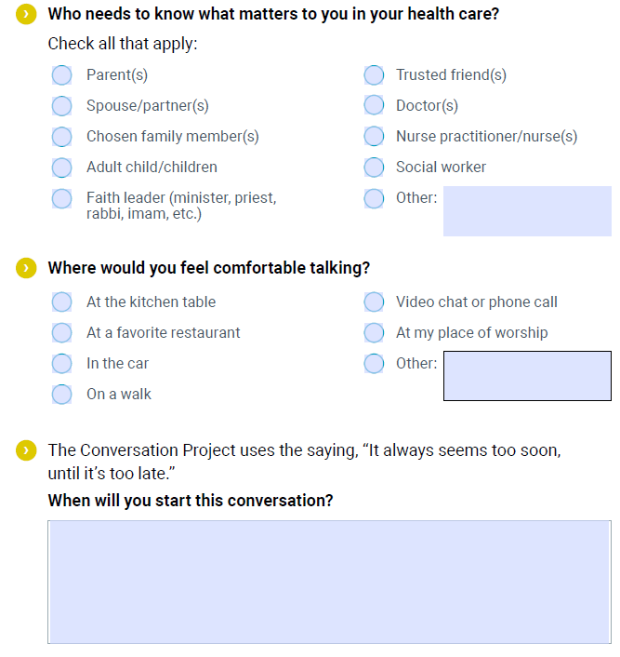
20
Notes:
Script: So, now you have something you would like to tell someone! Great! Let’s turn to the next section headed “Step 3: Start Talking”. Who do you want to talk to? Where would you AND those you want to talk with feel comfortable talking? When would be a good time to talk?
Tip: depending on your time, you may be able to give people time to work on this section, or just point out a few ideas to guide them, e.g.: tell more than one person; talk over time and sooner rather than later; it’s not one giant conversation; it can be had in small pieces—like dropping a gem in another conversation—over time. And it doesn’t have to be an in-person conversation. Phone, FaceTime, Zoom etc. can work. People can print it, do it online, email it to someone, write a letter, etc.
20

Slide 21
When to have a conversation
21
Early
  Coming of age – 18 & 21
Often
  Before a medical crisis – 30, 40, 50, 60, 70
Major life event
  College, marriage, children, divorce, Medicare, death in the family
Major trip
Newly diagnosed with a serious illness
Notes:
Key point: Have a Conversation(s) over time, sooner rather than later, don’t wait for crisis in the ICU.
Tip: If you have brief stories about sharing the conversation—humorous or touching--this is a good point to insert them if you have time.
Script: When should we be having The Conversation? (they you can read from the slide)

Slide 22
What did you learn?
22
What plans did you make?
Questions
Concerns
Surprises
Trends
Notes:
This is a moment to share their thoughts, comments and concerns after they have made their plans.

Slide 23
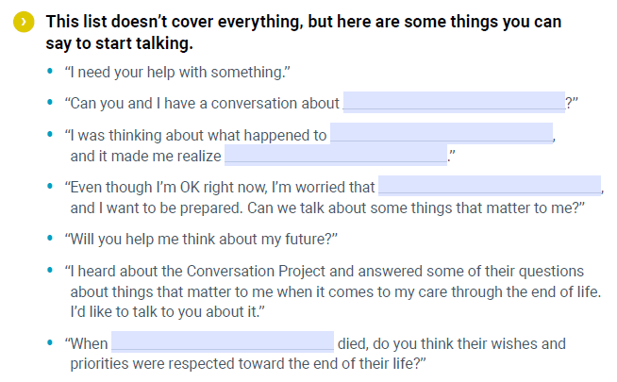
How to start
23
Notes:
Script: But how do you actually bring it up? We offer a page of “ice-breakers” that we hope will help you.
Tip: you can point out 1-2 of your favorites.
Note: Part of our strategy is to incorporate accountability into the workshop process. If you are able to offer a follow up session you can remind people of that now: We will be holding a follow up session to this introduction. Part 2 is an opportunity to return to report on and process the experience of having had The Conversation. How did it go—or not go? What questions do you have now? What else do you need to learn? How can we support one another in community to keep going—to talk with all the people in our circle of care, get a health care proxy, talk with our clinicians, and review or revisit our wishes in the face of a change in status? Etc.

Slide 24
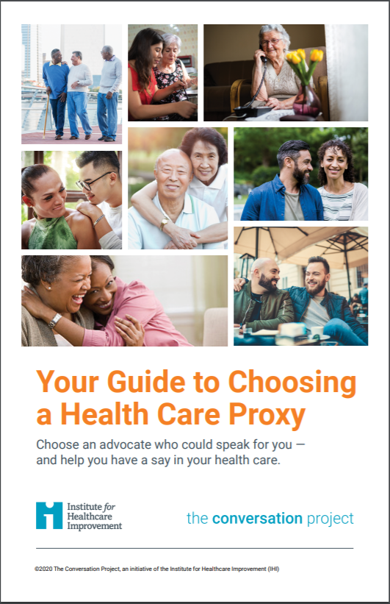
24
Help those who matter most know what matters most to you
Who would you want to make medical decisions for you if you were unable to make them yourself?
Notes:
Script: We find one of the best ways to start is by talking about a health care proxy first. Proxy framing can be a softer entrance (who would speak for you if you can’t speak for yourself). Some folks can handle the idea of an accident that they will recover from better. And, if COVID taught us anything, it was that no matter the age, we were all vulnerable to something unexpected happening where we may not be able to speak up for ourselves. Making sure you have a trusted decision maker to be your advocate is something most can relate to.
Note: This doesn’t have to be a spouse, parent, child – it should be someone you are comfortable with who you trust to honor YOUR wishes

Slide 25
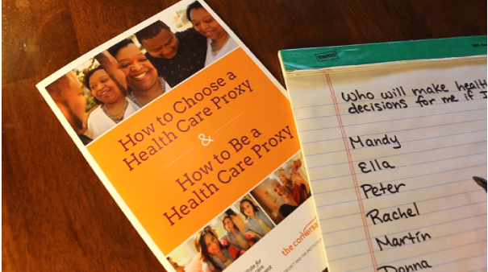
Who will speak for you video
25
https://youtu.be/0TFyfwWziPM
Notes:
Tip: You may choose to show rather than tell people that choosing a proxy is a great way to start The Conversation.
Note: Clicking on the link will exit the PowerPoint, and open the video on YouTube. You may choose to embed the video into the PowerPoint instead. If you play videos, make sure you have strong internet access and test ahead of time. You can open up You Tube videos and play ahead of time so they are already loaded and ready to go.

Slide 26
Practice with a partner
26
Think about how you may start this conversation with someone who matters/someone who may speak on your behalf someday
- 1 min
Turn to your partner and take turns practicing!
5 minutes
Notes:
Tip: If you have ample time, you could offer people a chance to practice their opening gambit with others in the group. Our workshop leaders find they don’t usually have this time, even with a 90 minute session.
Note: Help folks focus on icebreakers they could use to start a conversation. If in-person, have them turn and talk with their neighbor. If doing a virtual session, either set up breakouts or ask folks to chat in how they may start a conversation once they take this home with them.
Script: Now that we’ve gone over some ways to jump start a conversation – the one-liners in the kit, and the video examples shown early (Practice Makes Perfect) and the Proxy video – it’s your turn to practice. Which of the previous icebreakers might you use – or what other openers could resonate with someone you want to talk with?

Slide 27
Optional: additional topics
27
Advance care planning (ACP)
Advance directive (AD)
  Health care proxy/agent/durable power of attorney
  Living Will
MOLST/POLST
Notes:
Presenter – Decide ahead of time whether you want to include information about any of these topics and be prepared with state-specific information.
*caution about introducing MOLST/POLST: remember that POLST is for those who are seriously ill or have advanced frailty – it is not for everyone. This takes the conversation into clinical territory, if you are able to have this in a second session, we find it easier for folks to focus on the values-based conversations first so not as daunting (and clinical conversations often go down the rabbit hole of scenario planning, which we cannot prepare for every type of scenario!) Just be sure to make this all clear!
If you won’t be addressing these things, have an idea of who to point people to (estate attorney? Doctor?) who might be able to answer questions people have after this session.
And you can invite people to join you in spreading TCP: People experiencing the Conversation Guide and learning about TCP’s mission are also discovering they want to be champions to spread that mission and model in their communities. We are here to support your doing that. We offer free, web-based trainings/recordings and regular community webinars for people around the country. Our web-based resource center is updated regularly to include examples of best practices from our faculty and from people who are learning what works in their communities—from hosting book discussion groups or Death Over Dinner events, to leading their health systems teams in integrating The Conversation Guide in their flow of work.

Slide 28
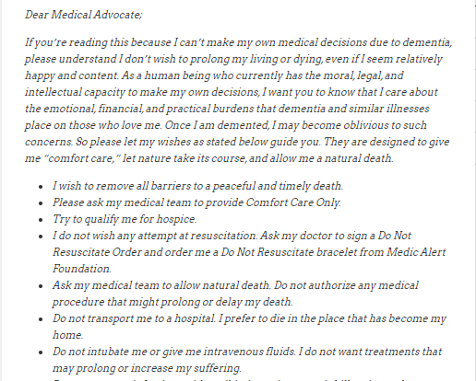
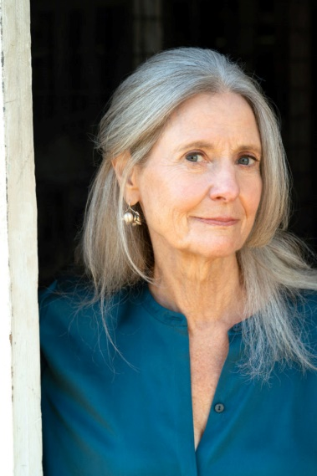
Tips from the field: role you want
28
No matter what role, make sure it’s known
  Woman who wanted kids to decide
  Katy Butler’s blog and letter to her family
TCP Blog: theconversationproject.org/tcp-blog/with-dementia-more-is-needed-than-a-boilerplate-advance-directive/
Adapted from The Art of Dying Well: A Practical Guide to a Good End of Life, by Katy Butler © 2019. Reprinted with permission of Scribner.
Notes:
Below and in the next 4 slides are stories we share that you can use to illustrate key points within our Conversation Guide:
Make the role you want to play known. Whether you want someone else to decide what’s best or if you want your wishes to be followed completely without stray – make sure this is known to those who may have to make decisions on your behalf.
A woman at one of our workshops noted she really wanted her adult kids to decide what kind of care she would receive and for them to make whatever decisions that brought them peace. This is the conversation she needs to have with them – to tell them this wish so they aren’t left wondering what their mom would have wanted.
Katy Butler, author, wrote a letter to her family laying out specifically what she would want (and not want) should she be diagnosed with dementia and were unable to make her own care decisions later. She wanted to be explicit and knew what she would want given the experiences she went through with her own father at the end of his life.

Slide 29
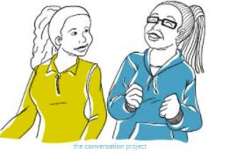
Tips from the field: type of care
29
Give current answers
  Current state mind and body
  A TCP leader and her husband
Home is not always feasible. Probe for what’s important.
  Nana and her cat
Be wary of “whole enchiladas” and “plug pulling”
  Aggressive comfort vs aggressive treatment
Notes:
What kind of care you want to receive?
Give current answers – a reminder that there is no way to discuss every hypothetical scenario that might come up for us (“will I get cancer? Be in a car accident??”) – a reminder to everyone as they continue with this process or introduce it to loved ones to encourage them to give answers based on what they would want right now. You can have another conversation if a new diagnosis or life change occurs – we hope you will have many conversations
One of our TCP leaders and her husband went through the Conversation Guide and shared their answers. Her husband started sharing what he would want in the future, as if he were over 80 with a diagnosis of Alzheimer’s. She stopped him and said: what if something should happen to you now. What is most important to you at this age and in your current health, body and mind?
Home is not always feasible. Probe for what’s important. We hear from many people that “my grandma said the only thing she wanted was to die at home and we just weren’t able to do that” – we know it isn’t always medically, financially, or physically feasible and that it can be important to learn more. Does your loved one have a pet they want to see? Are they afraid no one will visit them? What are the values behind “home” that are most important to incorporate? The story of Nana and her cat – one of our leaders grandmothers noted she wanted to die at home, when she unpacked “why” – she really just wanted to be sure to have her cat by her side.
Be wary of “whole enchiladas” and “plug pulling” – There are plenty of folks who think they’ve had “the conversation” – “if I ever get like that, pull the plug” or “make sure you give me the whole enchilada” come up a lot. That isn’t actually very helpful info! Encourage people to share more “it sounds like you’re worried about receiving too little care, is that right? Tell me more?” The scale questions can be really helpful here.

Slide 30
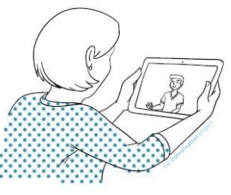
Tips from the field: roles others may play
30
Ask if this person will/can honor your wishes
  The Just Right story
  Church friends
Tell more than one person
  Seagull effect
Beware of family or caregiver “bullying”
  Florida family
  Keeping mom at the center
Invite others to share their wishes with you
  Eeyore example
Notes:
What role you want those that may be involved in your care (friend, family, loved one) to play?
Ask if this person will/can honor your wishes – It is important to ask if your loved one can honor your wishes. If not, you may want to find another health care agent/proxy. Our proxy guide has good tips for this.
Joy, a married mother of grown children, needed to choose her proxy. She talked to her husband first. He told her, “I could never unhook you from anything. I will hold your hand for 20 years even if you’re too sick to respond.” Joy then went to her son. He said, “Got it, Mom—I know you don’t want any extreme measures to save your life. I’ll never let anyone hook you up.” Finally, Joy went to her daughter, who said, “I hear what’s important to you and I know any choice I would make should depend on your prognosis and chances for recovery.” After hearing that her daughter had really listened to her, while her husband and son weren’t able to put aside their own thoughts and feelings in decision-making, Joy chose her daughter as her proxy.
Chosen in Good Faith: Sofia, age 59, and Alex, age 42, attended a Start-a-Conversation workshop at their church. Sofia had health issues and knew she needed a proxy—but was single, with no kids, and estranged from her family. Alex was a healthy single person with two brothers—neither of whom she’d be comfortable asking to be her proxy. At the end of the workshop, the speaker encouraged attendees to choose a proxy. He added that if people didn’t have an obvious choice in their lives, they might find someone in the group capable of serving. Sofia and Alex had sat next to each other many times in church, so they turned to each other and started talking. After meeting for coffee several times and talking about what matters to them and what’s important in a proxy, they felt comfortable choosing each other.
Tell more than one person – If you have a large family, or multiple people who will want to be involved with your care at the end of life, it can make a big difference to keep folks in the loop. Not everyone needs the full details, but at the very least saying something like “Suzy is in charge if I ever need someone to make health care decisions – we’ve talked about what I want and I hope you’ll all support her” can go a long way.
*We are hoping to avoid the “Seagull effect”: the out-of-town sibling who doesn’t know what their parent may want swoops in and “dumps” all over the carefully made plans of those who are right by the parent’s side and know what the parent wants.
Beware of family or caregiver “bullying” : A family member at a workshop realized she and her siblings had been imposing their wants and needs on their father instead of really listening and following what he wanted. He had a recent health episode that they thought would be best dealt with at the ER. They made him go to the ER, even though he repeatedly said he did not want to go back to the hospital. While they did this out of a place of love, it was against their father’s wishes.
Invite others to share their wishes with you – this doesn’t need to be a one-way conversation from you to them. Encourage others to think about their wishes as well!
Washington State - Woman shared her husband is like Eeyore, not wanting to talk about his wishes, she said OK, here is what I will do for you then, tell me if you want otherwise!

Slide 31
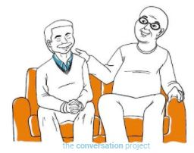
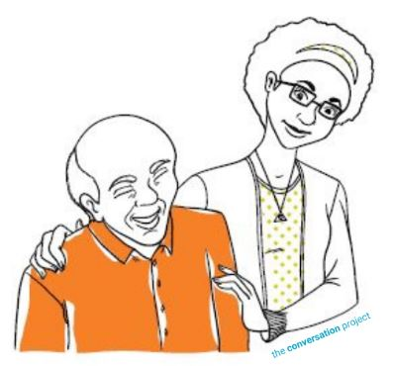
Tips from the field
31
The opportunity to strengthen relationships – these are very loving conversations and don’t have to be serious
Notes:
The opportunity to strengthen relationships – these are very loving conversations and don’t have to be serious. Over and over we hear that these conversations weren’t as scary/sad as people thought they might be. They can be funny and loving – and also take place over multiple conversations. If you don’t get into all the details the first time around, keep going!

Slide 32
Leaving in action
32
Complete the Conversation Starter Guide
Pick your person, start the conversation with someone who may speak on your behalf
Document your proxy and wishes
Bring What Matters to Me concept back to your organization / community

Slide 33
A change in approach
“I have elderly grandparents who live alone in another state, with nobody nearby to take care of them. I have suggested assisted living or having an aide come to their home for years but they always refuse. They have dementia and other health problems but have always been fiercely independent and mistrustful of others. I viewed your Conversation Project guides on my flight to Colorado and when I got here, I decided to change my usual approach to the issue. I started asking questions instead of telling them how worried I was. The questions I asked came straight out of your materials. Your guide was very helpful to start a 2-way conversation and I am so grateful for your initiative. Not only are they open to me being their healthcare proxy, they also have agreed to move to assisted living. I am so relieved, and so grateful for the information you made available at no cost to people. Thank you!”
Received April 2021
Notes:
Note: This is a story someone emailed to our team, letting us know how she used our guides to change up her approach with her aging grandparents. You can read this out loud to the group. This also is a great example of the listening part of a conversation, that we need to remember.
Script: Before we close out, one last story shared with The Conversation Project team to show how you might approach this with those who matter to you. [READ STORY].

Slide 34
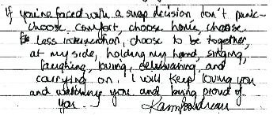

Don’t Panic – It’s OK: A letter to my family
34
If you are faced with a decision that you're not ready for,
It’s ok
I'll try to let you know what I would want for various circumstances,
But if you come to something we haven't anticipated,
It’s ok
And if you come to a decision point and what you decide results in my death,
It’s ok.
You don't need to worry that you've caused my death – you haven't –
I will die because of my illness or my body failing or whatever.
You don't need to feel responsible.
Forgiveness is not required,
But if you feel bad / responsible / guilty,
First of all don't and second of all,
You are loved and forgiven.
If you're faced with a snap decision, don't panic --
Choose comfort,
Choose home,
Choose less intervention,
Choose to be together, at my side, holding my hand,
Singing, laughing, loving, celebrating, and carrying on.
I will keep loving you and watching you and being proud of you.
Notes:
Tip: We find that people cannot always read this slide. Practice reading it (which may be hard for some to do without getting a little catch in your throat…); it can provide a moving, motivating closing to your presentation. Alternatively, you could play a audio/recording of Dr. Boudreau reading her letter: https://youtu.be/78LvYE3vMOA
Script: I’d like to close by reading a note Dr. Karen Boudreau, an early advisor to The Conversation Project, wrote to her young family. Perhaps it will help you express your wishes to your loved ones. You can find this again on the TCP website; search for “Don’t Panic” letter.

Slide 35
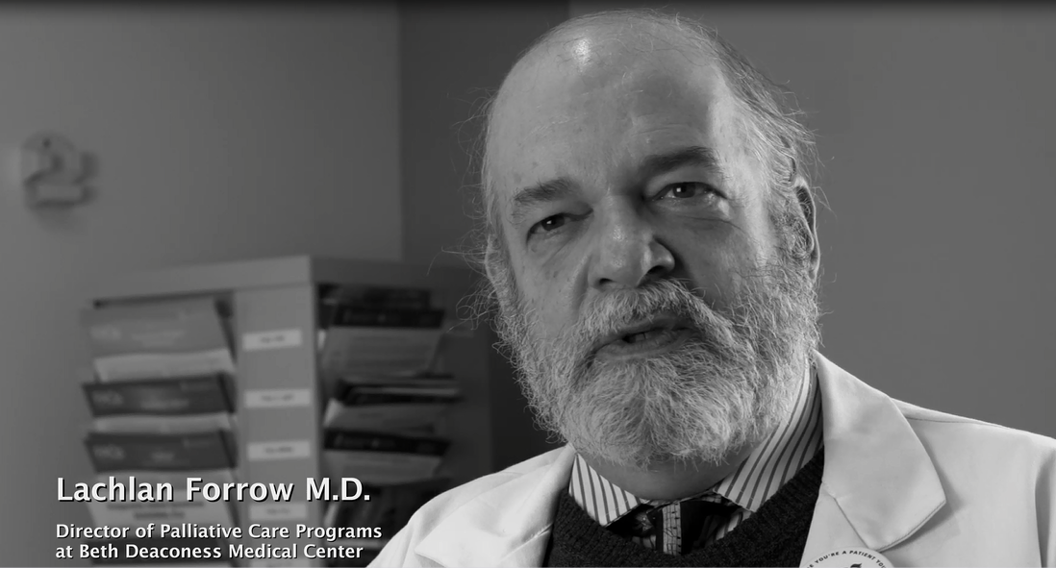
A soul doctor and a jazz singer
35
Notes:
This is another great video to end with, if you have a health care audience. This is also on our website.

Slide 36
Questions?
36
<Your name and organization>
<Your email address/phone number>
www.theconversationproject.org
Notes:
Key points: Thanks
Who you can connect with after
Details on a second session

Slide 37
Extra slides
Notes:
The following four slides can be in your “back pocket” and used depending on your audience (or skipped altogether)

Slide 38

What Matters TO Me?
Public Awareness Community Engagement
As Well As
Health Systems Transformation
What’s the Matter with Me?
Notes:
OPTIONAL: this and next slide on the conversation continuum – can be inserted after Slide 8 - if you have additional time and want to explain a bit more on how The Conversation Project works to affect change in the community and within health systems.
Script/Note: We are working towards that transformational culture change through a double helix model— influencing care from two directions. Through public awareness and community engagement and our work in Health Care systems, we are working toward having conversations that shift away from “what’s the matter with me” to more emphasis on “what matters TO me”…Conversations about our values, beliefs, and what makes life worth living are ones that we can enter into more readily—and with less fear. Whereas conversations about whether someone would want to be resuscitated, intubated (put on a ventilator or breathing machine), artificially fed. These can be distressing, complex. They entail making decisions we may someday need to make in consultation with a skillful health care team. And these decisions can be grounded in What Matters TO Me.
The important point I want to make is that we need to reflect on What Matters, and share it with those who may—someday—need to make critical decisions on our behalf…in the event that we cannot speak for ourselves.

Slide 39
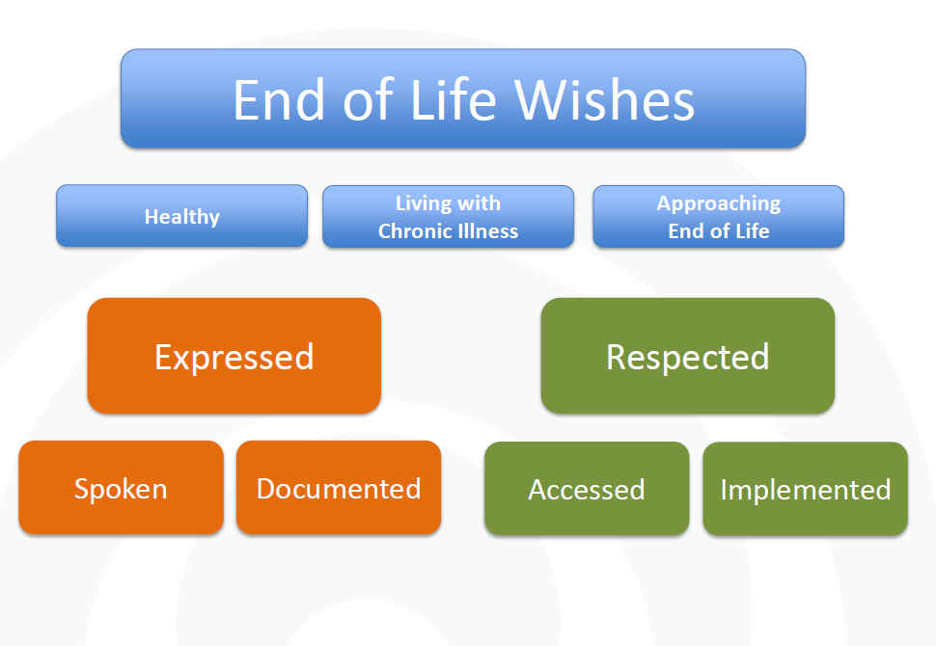
The conversation continuum
Notes:
OPTIONAL
Script: And we need to be having those conversations sooner rather than later. We encourage talking in a familiar setting –like at home, over a meal, taking a drive, in your congregation—not waiting until there is a medical crisis in the ICU. And these conversations need to happen across the spectrum of wellness to illness. We are not too young and we are not too healthy to begin having The Conversation.
Note: This diagram came from the Cambia Health Foundation, a key donor to The Conversation Project. It is a visual representation of the whole continuum, depicting having convo at three stages of life.
Express wishes earlier on: have a conversation and write down your wishes in state appropriate documents.
Further along the EOL spectrum, we aim to have wishes respected in health care systems: recorded wishes need to be accessible in the system and then implemented care plan respects one’s wishes. Note that we believe it is important to document your wishes, but they don’t do much good without a conversation to go along with them. We hear stories of documents in filing cabinets or safety deposit boxes that no one knew about. Or old documents that pull in one decision maker but none of the other family members were made aware ahead of time. Conversations are a key component to advance care planning – whether with those that matter most in our lives or health care providers.
We are trying to spread out the amount of time between having the conversation and when it needs to be put into action
*Nice visual. You don’t have to use it.

Slide 40
Notes:
OPTIONAL: this and the next slide can be inserted after Slide 24
Script: Another great way to start the conversation is if someone you care about has been diagnosed with a serious illness. This workbook is a great place to start.

Slide 41
Name a health care proxy
Complete a POLST w. clinician
Complete The Conversation Starter Guide; Talk to your family
Serious illness conversation with clinician
End-of-life
talk
HEALTH TRAJECTORY
HEALTHY------------------------ILL--------------END-OF-LIFE
ONGOING CONVERSATIONS AND DOCUMENTATION
Izumi S and Fromme EK, Journal of Palliative Medicine. March 2017, 20(3): 220-221.
Notes:
OPTIONAL
Note: This can be a nice visual to talk about what steps to take, resources to use and how to start along the continuum of your health trajectory.
Script: Another way to think about where our Conversation Guides and workbook fit and where to start, is by starting at the top, making your way down this continuum of a person’s health. Starting from healthy to a diagnosis of illness to end-of-life (left hand sidebar) – everyone should name a health care proxy, talk with this person so they know what matters.

