Slide 1
Death Over Dinner
DATE
Why should college students should care about advance care planning?
PRESENTER NAMES
Notes:
Title this however it works. This is an example if you host a discussion over dinner!

Slide 2
Welcome and some discussion
Notes:
Questions could include:
- What comes to mind when you hear the word "death?"
- Do you know what a health care proxy/agent is?
- Do you have a health care proxy/agent?
- Why don't you have a health care proxy/agent?
Always great to open by sharing your story too. Why this is important to you, what experience you may have personally with end of life. Then, invite others to share their experiences.

Slide 3
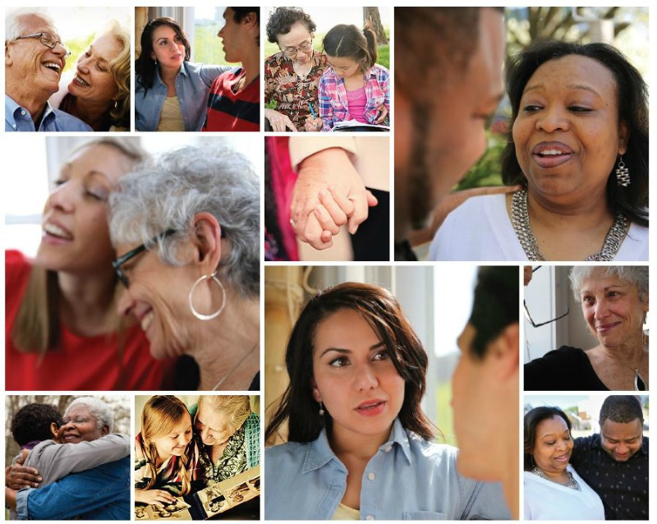

Slide 4
Helping people share their wishes for care through the end of life.
Notes:
Script: At The Conversation Project, we are a national public engagement campaign dedicated to assuring that everyone’s wishes for care through the end of life are Expressed and Respected. We are raising awareness; providing free, easy-to-use guides on our website; and connecting with people where we live, work, pray and learn. Too many people die in a manner they would not choose, and too many of those that matter most are left feeling bereaved, guilty, and uncertain. The Conversation Project is dedicated to changing the current norm.

Slide 5
Why Talking Matters
We can’t plan for everything. But we can share what matters to us with the people who matter most to us.
Talking creates the foundation of a care plan built on our values—a plan that will be available when the need arises.
Notes:
Why does this matter? We can’t plan for everything. But we can share what matters to us with the people who matter most to us. By talking about our values—what matters most to us in our life, and in our health care—we can help those around us make sure we get the kind of health care that’s right for us through the end of life.
Discussing our values and wishes can bring us closer to people. And talking with important people in our lives and our health care team, creates the foundation of a care plan built on what’s important to us that will be available when the need arises.
Of note: The Conversation Project has no preference for the type of care someone might want to receive. For us, it is important to encourage these conversations early and often. We know it’s always too soon until it’s too late and that a crisis is a terrible time to learn.

Slide 6
“Our ultimate goal, after all, is not a good death but a good life to the very end.”
~ Atul Gawande
Notes:
Script: And an ultimate goal is to have a good life to the very end! We believe that, together, we can transform how we die—one conversation at a time.
We know not everyone is given equal opportunity for a good life. Note our survey findings that Black and Latinx communities need support – refer to Kate’s blog as part of our work to ensure everyone is reached and listened to – don’t want to create further inequities of care at end of life. Uber important.

Slide 7
ABC Diane Sawyer Video
https://youtu.be/J1r0Xbh0UVo

Slide 8
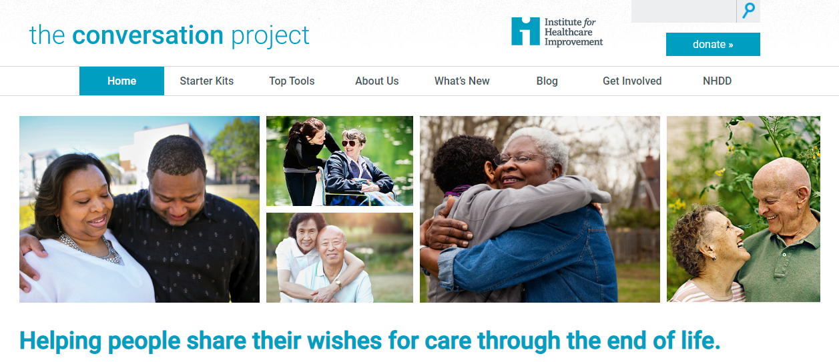
Our Website
Notes:
Key point: Introduce TCP website and free, downloadable resources.
Script: So, we want to have these conversations…and something gets in our way. We hear that people don’t want to upset their loved ones by bringing it up…and we know that people will feel relief if they do start talking. Mostly, people don’t know how to bring it up—or what to talk about.

Slide 9
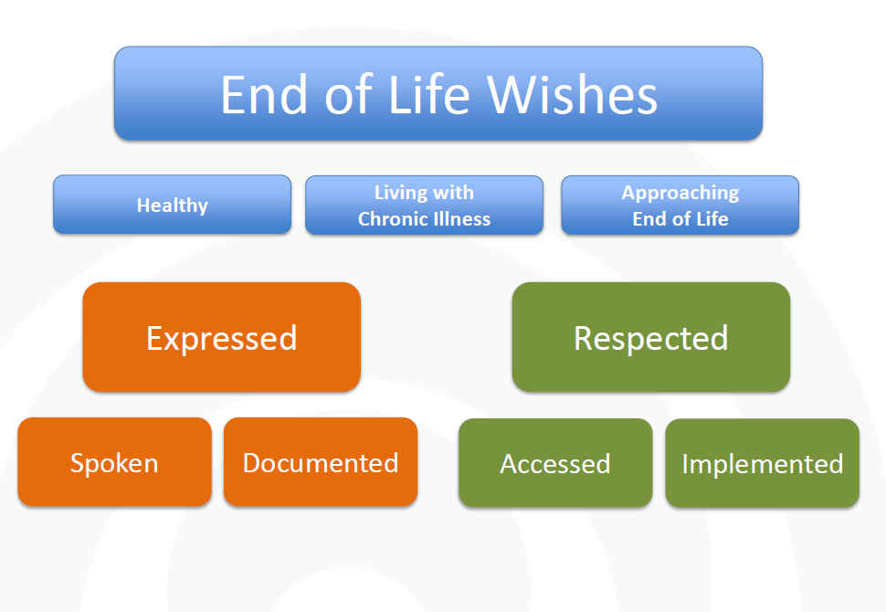
The Conversation Continuum

Slide 10
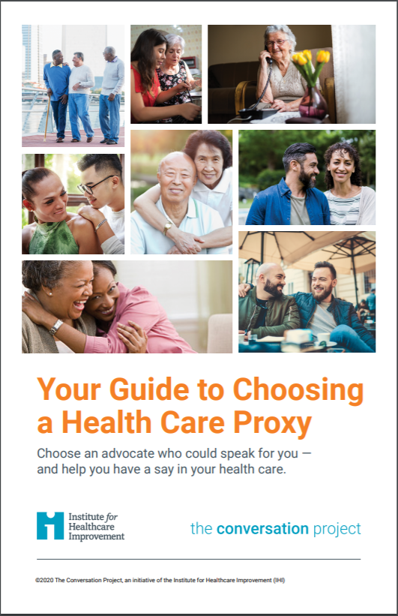
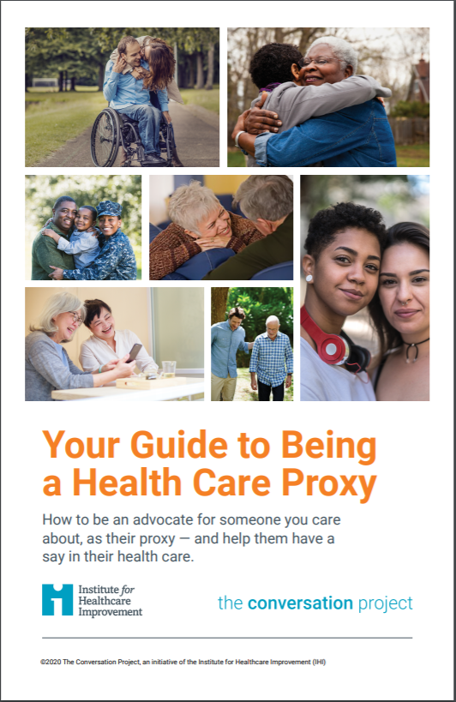

Slide 11
Choosing a Health Care Proxy
Who would you want to make medical decisions for you if you were unable to make them for yourself?

Slide 12
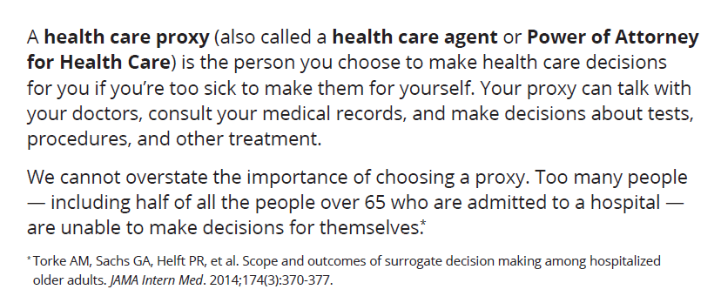
Definition

Slide 13
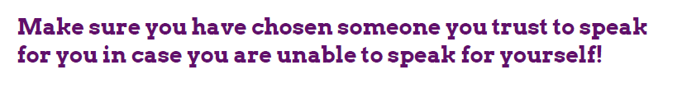

Slide 14
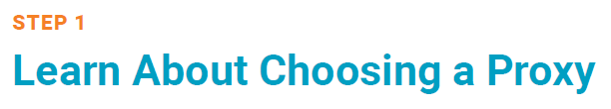




Slide 15
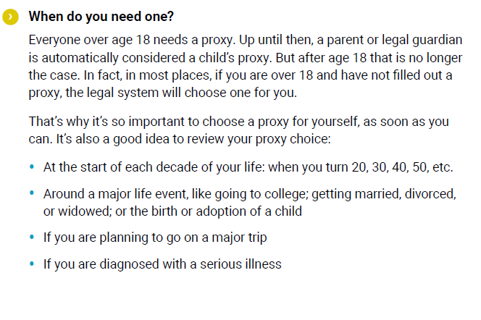
Notes:
Highlight importance of turning 18 – parents no longer have access to medical records

Slide 16
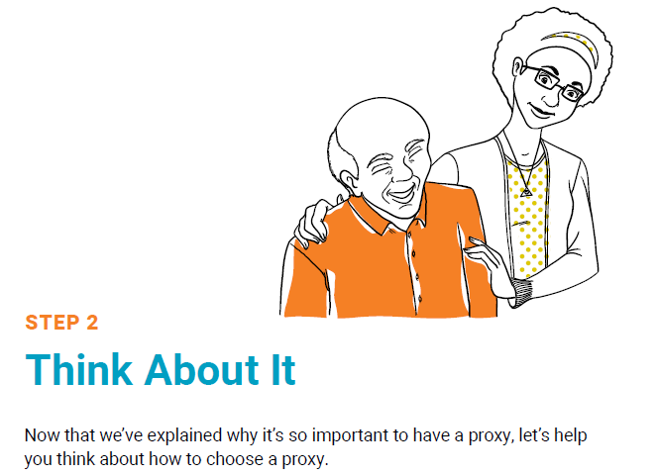

Slide 17
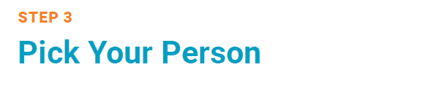

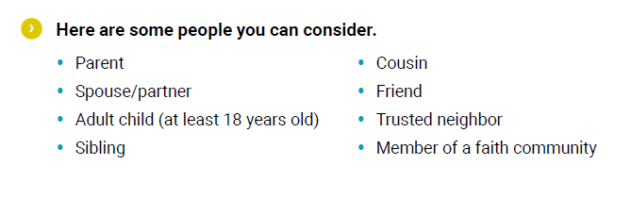
Notes:
Doesn’t have to be a parent/family member.
For example…
Parents live far away (different country) or don’t speak English – someone local as full proxy or first proxy until parents can get to town. Example of divinity student from Australia who has a US proxy lined up until his mom could get to the states
People who have fraught relationships with their parents. I have a friend whose parents don’t really speak to her since she came out. She explicitly states they cannot make decisions and that her proxy gets to decide if/when they can visit
If they think the parents will be too upset to cope. This is an important one to explain to parents/ask them about. Some young people feel that if something unexpected/terrible happens to them that they wouldn’t want to put their parents in the position of making decisions. If they trust someone else, maybe have a conversation about that with the parents. It might be more upsetting to the parents to NOT be involved – but is worth a conversation.
17

Slide 18
Discussion
Who would you choose as your proxy?
Why would you choose that person?

Slide 19
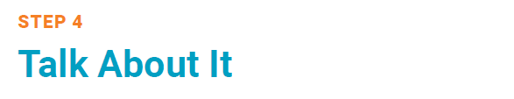

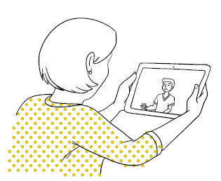

Slide 20
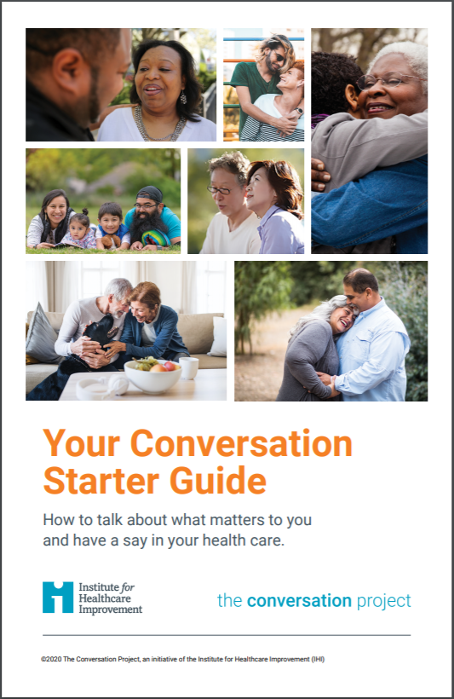
Notes:
The CSG can help you start that conversation with your HCP

Slide 21
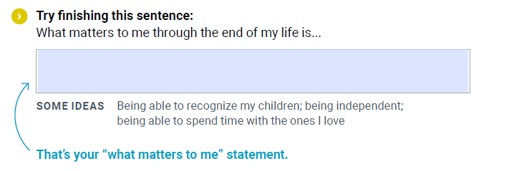
Reflection
From the Conversation Starter Guide pg. 3
Then discuss with your group.

Slide 22
Questions?

Slide 23
Next Steps
Before you leave, complete an evaluation on today’s session!
Complete a state-specific health care proxy form
Bring this subject up with your parents and grandparents
Notes:
More suggestions on pg. 8 of CSG
http://www.caringinfo.org/
ABA
AARP

Slide 24




Keep Connected
Twitter: @convoproject
Facebook: The Conversation Project
Instagram: convoproject
YouTube
Newsletters
  General
  Community Engagement

