Slide 1
Death Over Dinner
DATE
Why should college students should care about advance care planning?
PRESENTER NAMES

Slide 2
Welcome and some discussion
Notes:
Questions could include:
- What comes to mind when you hear the word "death?" - Do you know what a health care proxy/agent is? - Do you have a health care proxy/agent?
- Why don't you have a health care proxy/agent?

Slide 5
ABC Diane Sawyer Video
https://youtu.be/J1r0Xbh0UVo

Slide 6
7
0
%
WANT TO DIE AT HOME.
Notes:
Script: We know that not every family looks or interacts like the Jennings! And more people could be having The Conversation to better insure that their wishes will be respected. Talking about our wishes will—we believe--narrow the gap between what we hope and what is happening.
For example, in study after study, we learn that 70% of Americans hope to die at home.
Note: * These statistics come from a 2012 study from the California Healthcare Foundation on Californian’s attitudes and experiences with death and dying.

Slide 7
7
0
%
ACTUALLY DIE IN A
HEALTHCARE FACILITY
Notes:
Script: In reality, though, 70% die elsewhere—in hospitals and nursing homes. This is not a judgement about whether one place is better than another. It is simply pointing to the gap between expectations and reality. Talking about our hopes and making plans accordingly may help narrow this gap.
(Additional notes you may use: Only 10% of Americans die suddenly. 90% of us will live with a chronic or advancing illness, or into old old age and see our deaths approaching from some way off. About 20% of us will spend our final 10 days in intensive care, undergoing invasive, expensive, and sometimes futile treatment. Treatment some people may not have wanted if they could have spoken for themselves…
(If you wish to add some humor: And, despite every innovative therapy, the mortality rate is still 100%! )

Slide 8
8
0
%
WANT TO TALK TO THEIR DOCTORS
Notes:
Script: 80% of Americans say they would like to talk with their doctors about their wishes for care at the end of life….

Slide 9
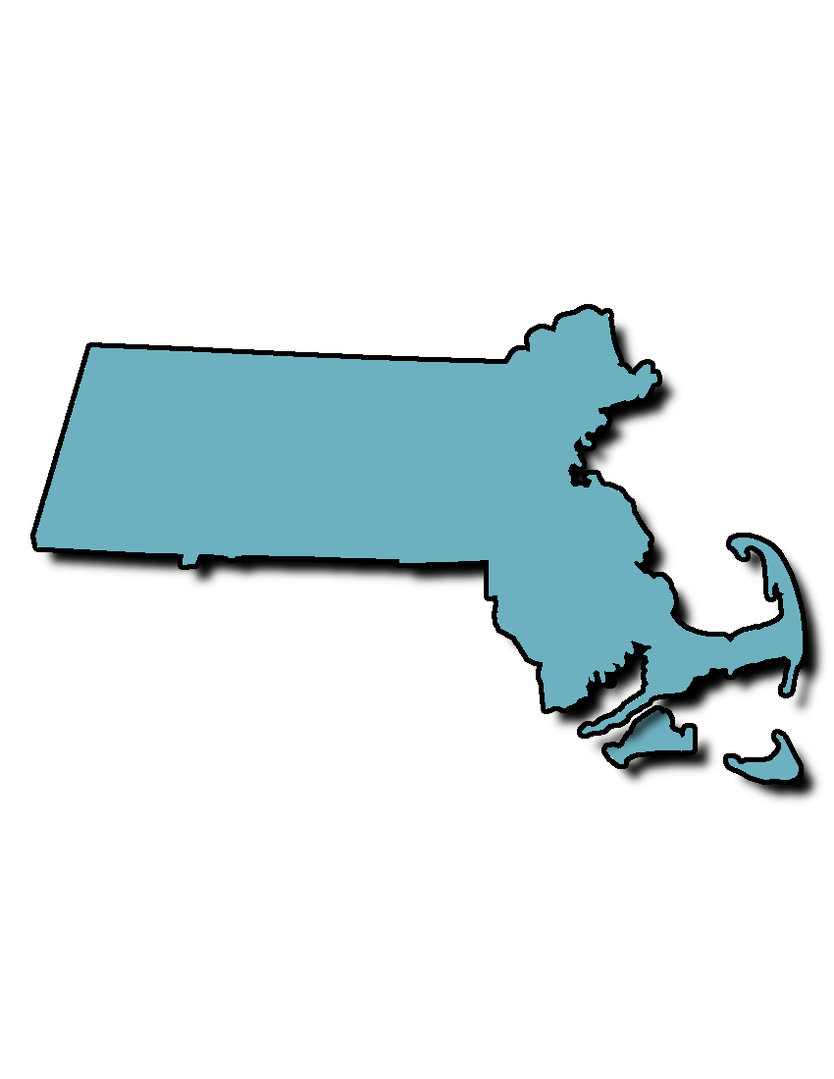
1
7
%
MASS
HAVE HAD A CONVERSATION WITH THEIR DOCTORS
Notes:
Script: Yet, in Massachusetts (where TCP is based): only 17% have had a conversation with their health care providers

Slide 10
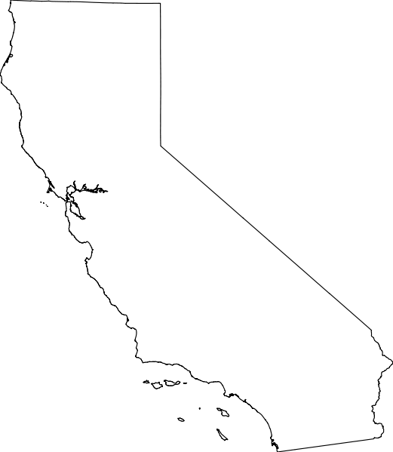
7
%
California
HAVE HAD A CONVERSATION WITH THEIR DOCTORS
Notes:
Script: And in California, that number is less than 10%. From coast to coast, we can do better.

Slide 11
9
2
%
THINK IT’S IMPORTANT
TO HAVE END-OF-LIFE CONVERSATIONS
Notes:
Script: In a national survey we conducted, we learned that 92% of American adults think it is important to have EOL conversations with their loved ones. Do you want to guess how many of us are actually doing it? ….

Slide 12
3
2
%
HAVE ACTUALLY DONE SO
Notes:
Script: Just 32%... While this isn’t a great percentage, we are encouraged that this statistic has improved since we did our first study 5 years ago!
Over and over, we hear that very often the difference between what we hope and what will very likely happen at the end of life—the difference between what we might call a good death or a hard death--is a conversation.
*These statistics are from The Conversation Project’s National Survey (2018)

Slide 13
5
0
%
FEEL RELIEF FROM HAVING THE CONVERSATION
Notes:
Script: And here is a motivating statistic: Although people express nervousness or reluctance about starting the Conversation, once they do, over 50% say the feel relieved that they are finally talking about something that matters so much.
One of our goals–one I think you share--is to narrow the gap between hope and reality.

Slide 14
The Conversation Continuum

Slide 15
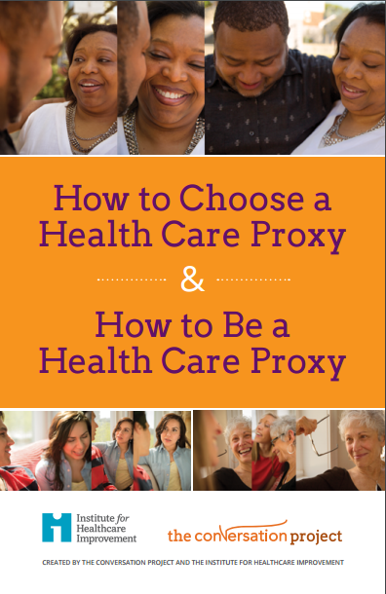

Slide 16
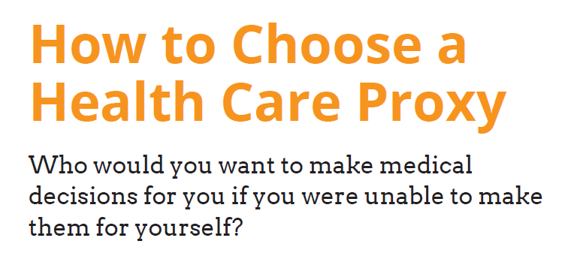

Slide 17
Definition

Slide 20
Notes:
Highlight importance of turning 18 – parents no longer have access to medical records

Slide 21
Notes:
If possible, bring forms for your state!

Slide 22
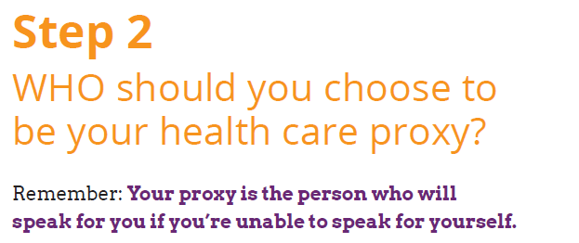
Notes:
Doesn’t have to be a parent/family member.
For example…
Parents live far away (different country) or don’t speak English – someone local as full proxy or first proxy until parents can get to town. Example of divinity student from Australia who has a US proxy lined up until his mom could get to the states
People who have fraught relationships with their parents. I have a friend whose parents don’t really speak to her since she came out. She explicitly states they cannot make decisions and that her proxy gets to decide if/when they can visit
If they think the parents will be too upset to cope. This is an important one to explain to parents/ask them about. Some young people feel that if something unexpected/terrible happens to them that they wouldn’t want to put their parents in the position of making decisions. If they trust someone else, maybe have a conversation about that with the parents. It might be more upsetting to the parents to NOT be involved – but is worth a conversation.
22

Slide 23
Frequently Asked Questions

Slide 24
Discussion
Who would you choose as your proxy?
Why would you choose that person?

Slide 26
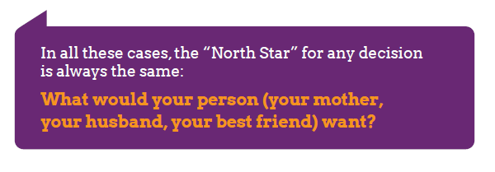

Slide 27
Notes:
The CSK can help you start that conversation with your HCP

Slide 28
Reflection
Form the Conversation Starter Kit pg. 4
Then discuss with your group.

Slide 29
Questions?

Slide 30
Next Steps
Before you leave, complete an evaluation on today’s session!
Complete a state-specific health care proxy form
Bring this subject up with your parents and grandparents
Notes:
More suggestions on pg. 8 of CSK
http://www.caringinfo.org/
ABA
AARP

